Slide 1
Acute Stroke
for Nurses Final Exam !!!
Charles Tuen M.D.
Board certified in Neurology
Methodist Charlton Medical Center
Updated 04/29/2020

Slide 2
Final Exam

Slide 3
Test 1
64 years old, weak all over
Last known normal yesterday
BP: 80/40, Temp 99
Q:
1. Call code stroke?
2. TPA?

Slide 4
Case 1: Discussion
Stroke usually affect one side instead of both sides
LKN: over 24 hr
Low
Low BP may cause weakness all over
No need to call a code stroke.

Slide 5
Test 2
88 years old, fell hard yesterday, hit head
Last known normal 1 hour ago.
Headache, speech problem, Right weak.
Q:
1. Call code stroke?
2. TPA?

Slide 6
Discuss: Test 2
Sudden onset neuro deficit
OK to call code stroke
Recent head injury, think about bleeding
Older patients are more likely to have bleeding in head

Slide 7
Test 3
25 years old female, right sided weakness
Fast heart rate at 110
Last known normal 1 hour ago
Q:
Call code stroke?
TPA?

Slide 8
Discussion: test 3
Sudden onset neuro deficit
Yes, call a code stroke.
Young patient can have stroke too.
Check drug screen
Blood vessel injury may cause stroke
Check pregnancy before giving any medication.

Slide 9
Test 4
66 years old, right sided weakness
Last known normal 2 hours ago
On Warfarin for atrial fibrillation
Q:
1. Call code stroke?
2. TPA candidate?

Slide 10
Discussion: test 4
Patient on Warfarin may still be a candidate for TPA
Need to check INR
TPA OK if INR < 1.7

Slide 11
Test 5
44 years old, had an argument w son
Last known normal 1 hour ago
Numb and tingling in face, both hands
Q:
Call code stroke?
TPA candidate?

Slide 12
Discussion: test 5
Bilateral face and limb tingling
Shortness of breath
Think about anxiety/panic attack

Slide 13
Test 6
78 years old, both legs weak
Back pain, no recent injury.
Last known normal 2 hours ago
Talk well, vision ok
Q:
Call code stroke?
TPA?

Slide 14
Discussion: Test 6
Bilateral leg weakness
Think about spine problem
Especially if patient has a fever or history of cancer

Slide 15
Test 7
77 years old, numb on right side
Last known to be normal 1 hour ago
No weakness, speech, vision normal.
Q:
Call code stroke?
TPA?

Slide 16
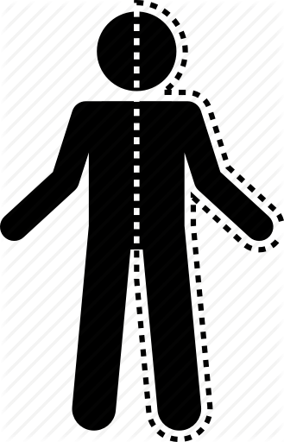
Discussion: case 7
Numbness on 1 side can be caused by a small stroke
With minimal symptom, TPA may not be indicated

Slide 17
Test 8
65 years old, woke up at 7 am
Severe right sided weakness.
Wife immediately call 911
Q:
Call code stroke?
TPA?

Slide 18
Discussion: Test 8
If it is less than 24 hr, call a code stroke.
But time of “Last known normal”?
Last known normal could be last night before he went to bed.

Slide 19
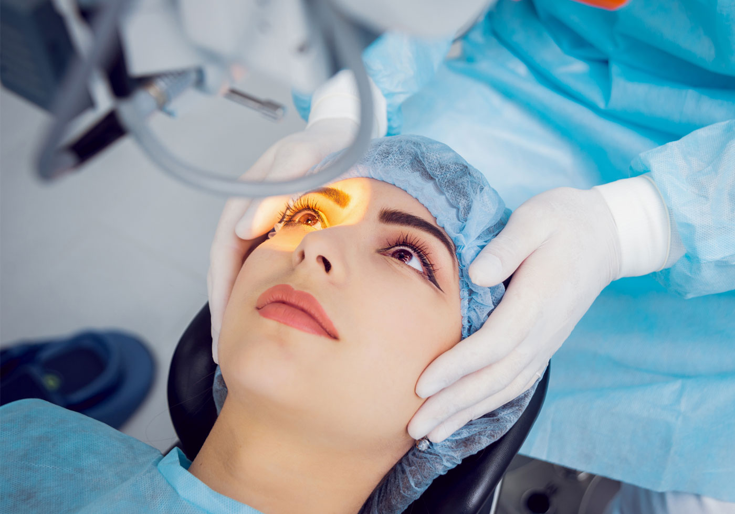
Test 9
70 years old, had cataract surgery yesterday
Right side severe weakness
Last known normal 1 hour ago
Q:
Call code stroke?
TPA?

Slide 20
Discussion: Test 9
Ok to call a code stroke.
It is not uncommon for patient to stop their blood thinner for surgery.

Slide 21
Test 10
66 years old, confused for 2 days.
When asked: Show me 2 fingers?
He answered: I am fine.
Q:
Call code stroke?
TPA?

Slide 22
Discussion: test 10
Unable to understand command is a sign of stroke.
They can talk but does not understand.
Called receptive aphasia.

Slide 23
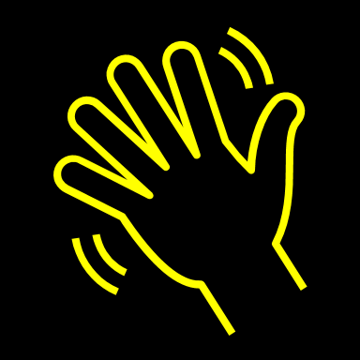
Thanks for your attention!
Now you are ready to
Save some brain tissue
Every minute counts
Have a wonderful day!

